Slide 1
“Timer and Interrupts in AVR microcontrollers and I2C communication”
By:
Laiba Sohail(2021-BSE-016)
Tanzeela Asghar(2021-BSE-032)
Neha Amjad(2021-BSE-024)

Slide 2
I, solemnly declare that the work presented in my BSE project titled "Presentation" is solely my research work with no significant contribution from any other person or Generative AI Tools. Any small contributions or help taken have been duly acknowledged/cited, and the complete project has been written by me in accordance with the latest plagiarism policy declared by HEC and my respective university in line with the policy for use of Generative AI Tools.
I understand the zero-tolerance policy of the HEC and FJWU towards plagiarism. Therefore, I, as the author of the above-titled assignment, declare that no portion of my project has been plagiarized, and any material used as a reference is properly referred/cited.
I undertake that if I am found guilty of any plagiarism in the above-titled project even after the award of my BSE degree, the University reserves the right to withdraw/revoke my degree. Furthermore, HEC and the University have the right to publish my name on the HEC/University website, where the names of students who submitted plagiarized projects are listed

Slide 3
Timer:
Timers in AVR microcontrollers have input pins designed to trigger input capture events. When a signal change is detected at such a pin, the timer value is immediately read and stored in the Input Capture Register (ICRx). Concurrently, the Input Capture Flag (ICFx) in the Timer/Counter Interrupt Flag Register (TIFRn) is set. This feature is particularly useful for measuring the duration of external pulses.

Slide 4
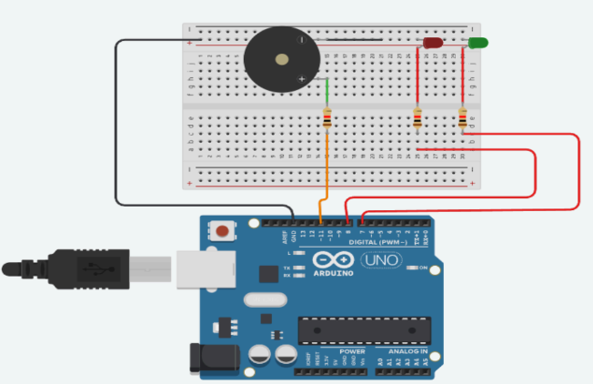

Slide 5
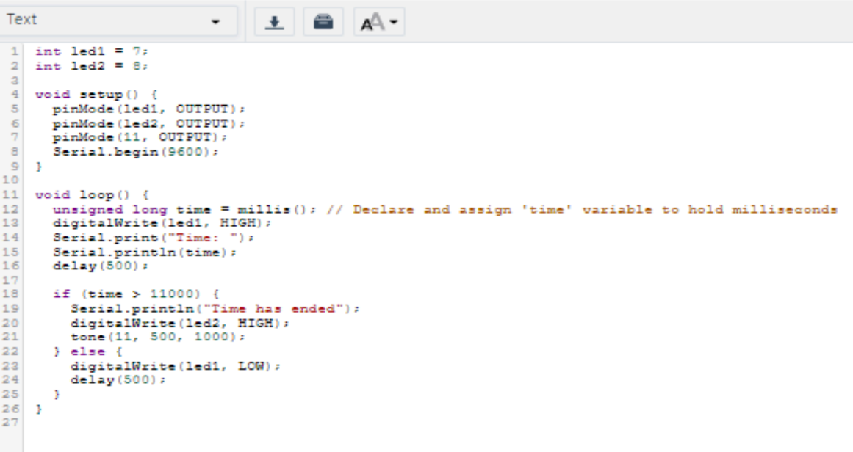

Slide 6
Components:
Arduino Uno: The main microcontroller board.
Breadboard: For prototyping the circuit.
LEDs (Red and Green): Connected to digital pins 7 and 8 through resistors.
Piezo Buzzer: Connected to digital pin 11 for sound output.
Resistors: Current limiting resistors for LEDs.
Connecting Wires: To establish connections between components and Arduino

Slide 7
Connections:
Red LED: Anode connected to digital pin 8 via a resistor, cathode connected to ground.
Green LED: Anode connected to digital pin 7 via a resistor, cathode connected to ground.
Buzzer: Connected to digital pin 11 and ground.
Power and Ground Lines: Connected from the Arduino to the breadboard to supply power to components

Slide 8
Interrupt:
AVR devices are equipped with external interrupts that can wake the device from sleep mode in response to a rising or falling edge signal or a change in the digital voltage level at an I/O pin. Once awakened, the device processes the application based on the interrupt source before returning to sleep mode.

Slide 9
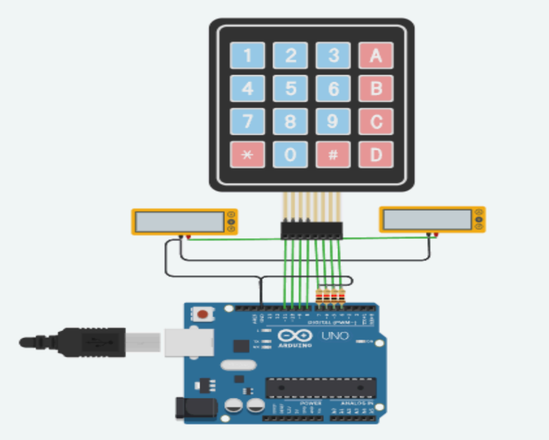
Circuit diagram:

Slide 10
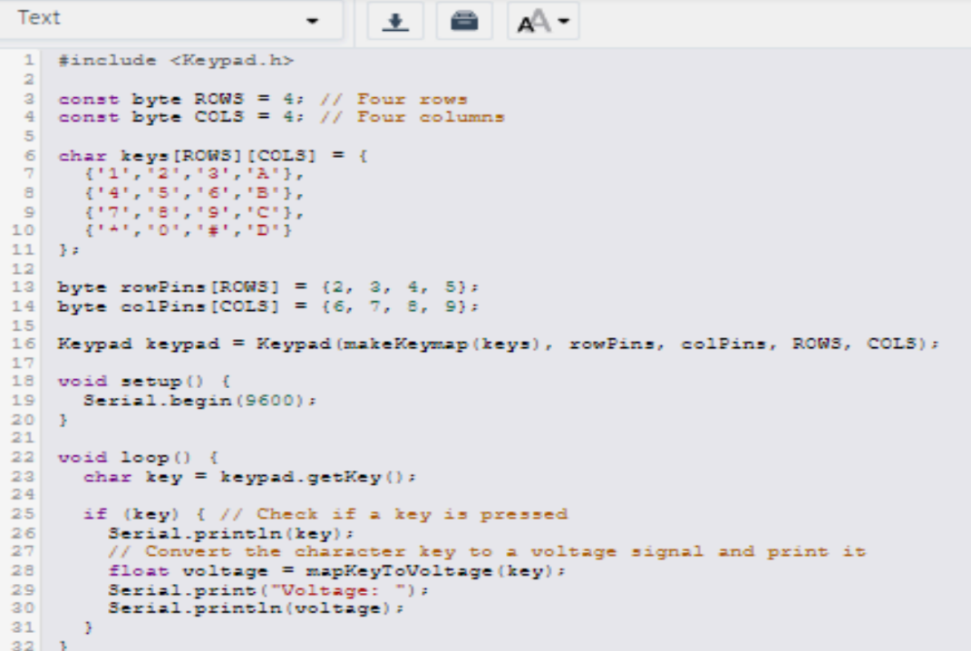
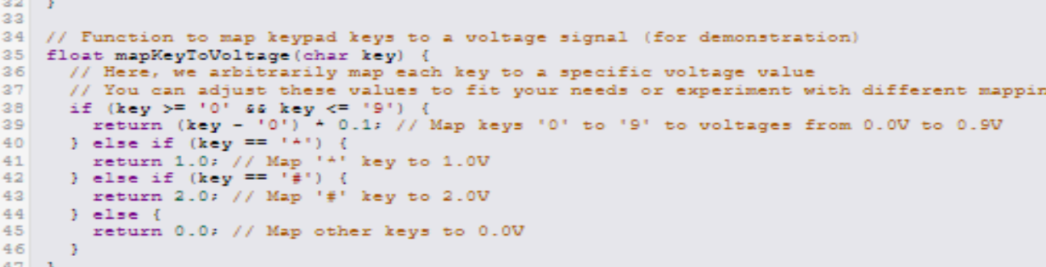
Code:

Slide 11
Rows (R1, R2, R3, R4) are connected to Arduino digital pins 2, 3, 4, 5.
Columns (C1, C2, C3, C4) are connected to Arduino digital pins 6, 7, 8, 9
The code sets up a 4x4 keypad and uses pin change interrupts to handle key presses. The keyPressed function is called whenever there is a change on one of the column pins.

Slide 12
Spi and I2C Communication:
I2C combines the best features of SPI and UART communication protocols. Like SPI, I2C allows you to connect multiple slave devices to a single master. Additionally, I2C supports multiple masters, enabling multiple microcontrollers to control one or more slaves. This feature is particularly useful when you need several microcontrollers to log data to a single memory card or display text on a single LCD.

Slide 13
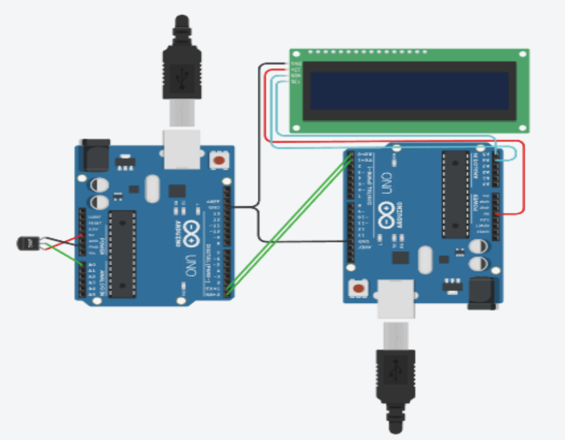
Circuit diagram:

Slide 14
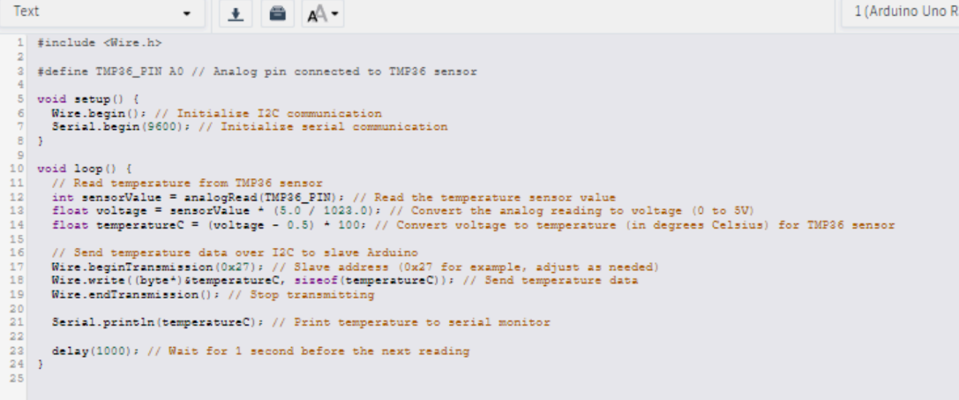
Code:

Slide 15
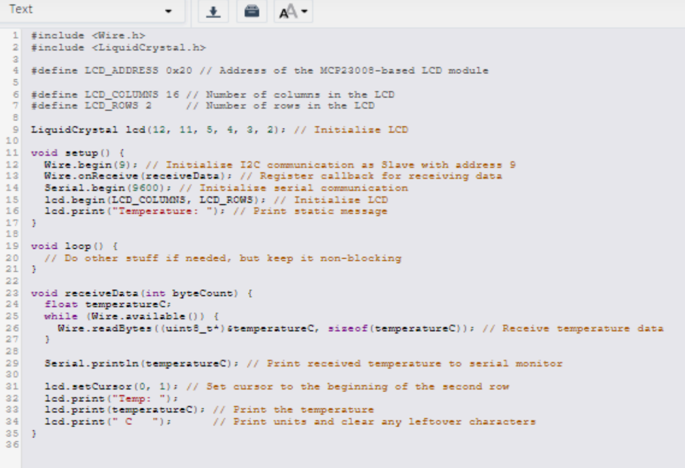

Slide 16
Components:
TMP36 Temperature Sensor: Connected to an analog input pin (A0) on the Arduino.
Arduino Uno (Master): Reads the temperature and sends it over I2C
MCP23008-based LCD Module: For I2C communication with the LCD.
Arduino Uno (Slave): Receives temperature data and displays it on the LCD.

Slide 17
The master Arduino reads temperature data from a TMP36 sensor and sends it via I2C to a slave
Arduino.
The slave Arduino receives the temperature data and displays it on an LCD screen.
The master Arduino also prints the temperature data to the serial monitor for debugging

